Slide 1

Intelligence Driven Defense,
The Next Generation SOC
Abdulrahman Al-Manea
aalmanea@stcs.com.sa

Slide 2

Objectives and Agenda
To explain what an Intelligence Driven Defense (IDD) approach is, in relation to the Cyber Kill Chain (CKC)®, and how it plays an effective role in thwarting Advance Persistent Threats (APTs) for a Next Generation SOC.
Compare Security Operations Center (SOC) vs. Next Generation SOC
Explain the Cyber Kill Chain (CKC)® methodology
Demonstrate an attack scenario and map it to CKC®
Show how IDD can help in measuring cyber security capability effectiveness
Present the Campaign Tracking metrics

Slide 3
SOC Vs Next Gen SOC (IDD)
SOC
Next Gen SOC
Monitor security infrastructure alerts, heavily dependent on default system alerts with minor customization
Proactively respond to cyber security incidents, heavily dependent on analyst customized rulesets and signatures

Slide 4
SOC Vs Next Gen SOC (IDD)
SOC
Next Gen SOC
Monitor security infrastructure alerts, heavily dependent on default system alerts with minor customization
Proactively respond to cyber security incidents, heavily dependent on analyst customized rulesets and signatures
Focused on incident resolution and ticket closure
i.e., a malware infected PC would get isolated and re-imaged as a resolution
Focused on intelligence gathering, documentation, deployment, and intel sharing
i.e., a malware infected PC would be analyzed forensically, reverse engineered,

Slide 5
SOC Vs Next Gen SOC (IDD)
SOC
Next Gen SOC
Monitor security infrastructure alerts, heavily dependent on default system alerts with minor customization
Proactively respond to cyber security incidents, heavily dependent on analyst customized rulesets and signatures
Focused on incident resolution and ticket closure
i.e., a malware infected PC would get isolated and re-imaged as a resolution
Focused on intelligence gathering, documentation, deployment, and intel sharing
i.e., a malware infected PC would be analyzed forensically, reverse engineered,
Not equipped for detecting/investigating APT, long-term campaigns
Requires higher network and system visibility than average SOC with a deployment of intelligence DB, threat hunting and Big Data.

Slide 6
SOC Vs Next Gen SOC (IDD)
SOC
Next Gen SOC
Monitor security infrastructure alerts, heavily dependent on default system alerts with minor customization
Proactively respond to cyber security incidents, heavily dependent on analyst customized rulesets and signatures
Focused on incident resolution and ticket closure
i.e., a malware infected PC would get isolated and re-imaged as a resolution
Focused on intelligence gathering, documentation, deployment, and intel sharing
i.e., a malware infected PC would be analyzed forensically, reverse engineered,
Not equipped for detecting/investigating APT, long-term campaigns
Requires higher network and system visibility than average SOC with a deployment of intelligence DB, threat hunting and Big Data.
The skill set is mainly related to security system administration (i.e., Firewall, IPS/IDS, HIPS, AV, SIEM, auth systems)
Skill sets mainly around forensics analysis, malware reverse engineering, attack analysis, incident handling, and system administrators

Slide 7
SOC Vs Next Gen SOC (IDD)
SOC
Next Gen SOC
Monitor security infrastructure alerts, heavily dependent on default system alerts with minor customization
Proactively respond to cyber security incidents, heavily dependent on analyst customized rulesets and signatures
Focused on incident resolution and ticket closure
i.e., a malware infected PC would get isolated and re-imaged as a resolution
Focused on intelligence gathering, documentation, deployment, and intel sharing
i.e., a malware infected PC would be analyzed forensically, reverse engineered,
Not equipped for detecting/investigating APT, long-term campaigns
Requires higher network and system visibility than average SOC with a deployment of intelligence DB, threat hunting and Big Data.
The skill set is mainly related to security system administration (i.e., Firewall, IPS/IDS, HIPS, AV, SIEM, auth systems)
Skill sets mainly around forensics analysis, malware reverse engineering, attack analysis, incident handling, and system administrators
One crucial foundation of an IDD approach is the adoption of the CKC® threat model

Slide 8
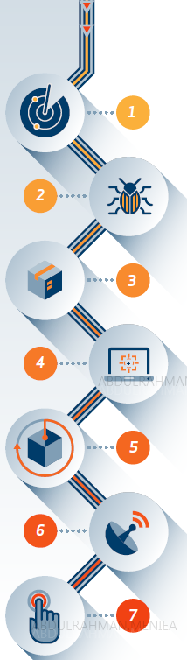
What is the Cyber Kill Chain (CKC)®?
A Term Derived from Offensive Military Tactics, Coined by Lockheed Martin (LM)
Allows for Proactive Remediation & Mitigation of Advanced Threats
A 7-Step Approach Depicting Stages of any Cyber Attack:
Reconnaissance
Attackers preparation phase, researching about the target victim.
Weaponization
Coupling malware (i.e., RAT) with an exploit.
Office/PDFs serve as a deliverable payload.
Delivery
The delivery method to victims, i.e.. email with malicious links/attachments, compromised websites, and removable media.
Exploitation
Executing attackers code, usually through an application and/or OS vulnerability.
Installation
Installing a backdoor to maintain persistent access.
Command & Control
Beaconing traffic out to C2 where adversary can remotely control victim machine, happens through web, DNS, and/or email.
Actions on Objectives
Installing a backdoor to maintain persistent access.

Slide 9


Attack Scenario
Phase | Attacker A
Recon | Email list harvesting (List A) Benign doc: newsLetter.pdf
Weaponi-zation | Basic Encryption Algorithm
 | Key 1, 8-bit key stored in the exploit code
Delivery | Subject: News Letter Update
 | Sender: Adam@Gmail.com
 | Gateway: 62.x.x.7
Exploit | CVE-2015-0531
Install | C:\....\FF\FirefoxUpdat.exe C:\.....\sysinternal.exe C:\….\Firefox.hlp
C2 | 41.x.x.7 [HTTP Request]
Actions on Objectives | N/A
Analyze
Detected
Synthesize

Slide 10
Attack Scenario
Phase | Attacker A | Attacker B
Recon | Email list harvesting (List A) Benign doc: newsLetter.pdf | Email list harvesting (List B) Benign doc: CV.pdf
Weaponi-zation | Basic Encryption Algorithm | Basic Encryption Algorithm
 | Key 1, 8-bit key stored in the exploit code | Key 1, 8-bit key stored in the exploit code
Delivery | Subject: Newsletter Update | Subject: Candidate Employee
 | Sender: Adam@Gmail.com | Sender: Adam@Gmail.com
 | Gateway: 62.x.x.7 | Gateway: 210.x.x.33
Exploit | CVE-2015-0531 | CVE-2016-013
Install | C:\....\FF\FirefoxUpdate.exe C:\.....\sysinternal.exe C:\….\Firefox.hlp | C:\....\FF\FirefoxUpdate.exe C:\.....\sysinternal.exe C:\….\Firefox.hlp
C2 | 41.x.x.7 [HTTP Request] | 41.x.x.7 [HTTP Request]
Actions on Objectives | N/A | N/A
Attribution

Slide 11
Attack Scenario
Phase | Attacker A | Attacker B | Attacker C
Recon | Email list harvesting (List A) Benign doc: newsLetter.pdf | Email list harvesting (List B) Benign doc: CV.pdf | Email list harvesting (List C) Benign doc: NewBusiness.PPT
Weaponi-zation | Basic Encryption Algorithm | Basic Encryption Algorithm | Basic Encryption Algorithm
 | Key 1, 8-bit key stored in the exploit code | Key 1, 8-bit key stored in the exploit code | Key 2, 8-bit key stored in the exploit code
Delivery | Subject: Newsletter Update | Subject: Candidate Employee | Subject: New Business Opportunity
 | Sender: Adam@Gmail.com | Sender: Adam@Gmail.com | Sender: Bob@Gmail.com
 | Gateway: 62.x.x.7 | Gateway: 210.x.x.33 | Gateway: 210.x.x.33
Exploit | CVE-2015-0531 | CVE-2016-013 | PPT 0-day vulnerability
Install | C:\....\FF\FirefoxUpdate.exe C:\.....\sysinternal.exe C:\….\Firefox.hlp | C:\....\FF\FirefoxUpdate.exe C:\.....\sysinternal.exe C:\….\Firefox.hlp | C:\....\FF\FirefoxUpdate.exe C:\.....\sysinternal.exe C:\….\Firefox.hlp
C2 | 41.x.x.7 [HTTP Request] | 41.x.x.7 [HTTP Request] | 41.x.x.7 [HTTP Request]
Actions on Objectives | N/A | N/A | N/A

Slide 12






Deep Dive Investigation
Email Analysis
Dynamic Analysis
Static Analysis
Code Analysis
Code Comparison

Slide 13
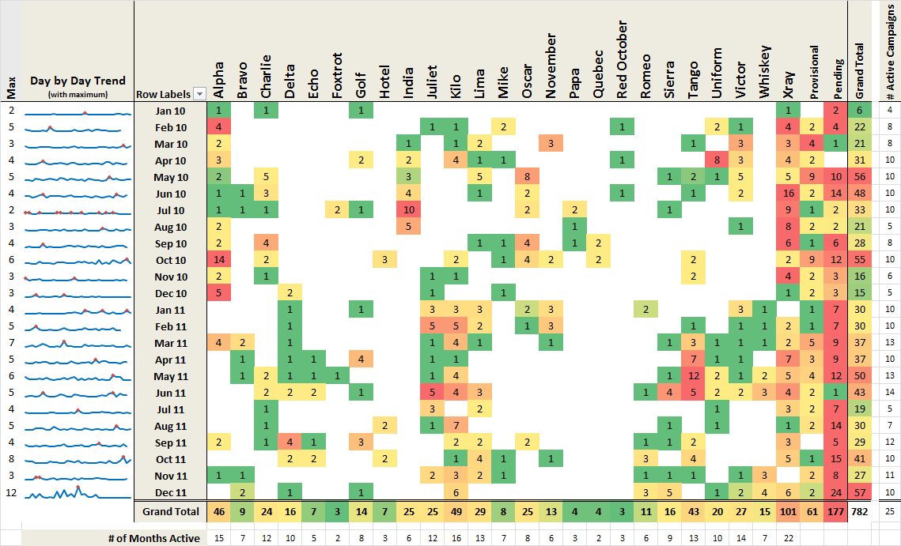
Campaign Tracking
Campaign Name
Monthly Statistics
Image Source: http://cyber.lockheedmartin.com/hubfs/docs/Technical_Papers/wp-seven-ways-to-apply-the-cyber-kill-chain-with-a-threat-intelligence-platform.pdf?t=1457726192514

Slide 14
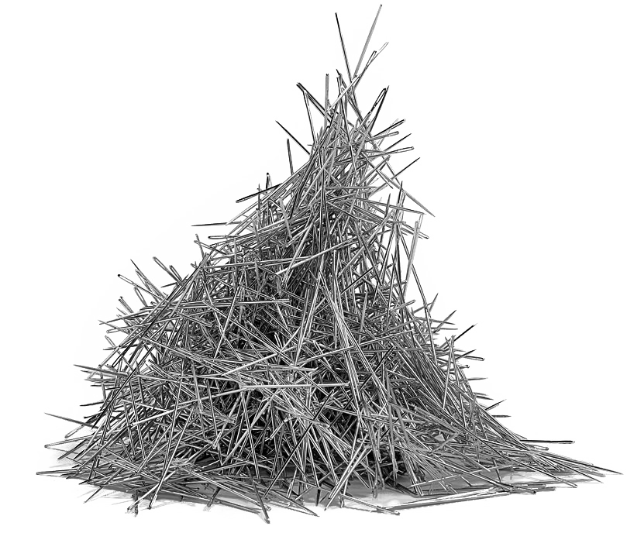
Conclusion – Dealing with APT
Looking for a needle in the needle stack
Traditional commercial security products are necessary but insufficient !
Sophisticated threats demand advanced intelligence, which calls for a Next Gen SOC
Implementation of all of your own extracted intelligence, makes it costly for an adversary to launch their next attack!

Slide 15
Thank You!

